Slide 1
Classes, Design, and Sequence Diagrams
Game 253

Slide 2
Introduction
Classes & STL
Debugging
Destructors
Parameter Passing
Responsibility
Sequence diagrams
Virtual Destructors

Slide 3
General Purpose Classes
Generated on the fly, maybe via factory, or object pool.
Reference based equality is useless; they are generated on the fly.
Overloading equality, as well as other reference based operators is recommended.

Slide 4
Classes & STL

Slide 5
Debugging
Dumping objects out to a console or log.

Slide 6
Debugging

Slide 7
Destructor
Clean up after yourself!

Slide 8
Destructor
Close open files
Close open network connections
Clean up pointers, deleting the referenced objects
Release access to shared resources
Alter global variables, instance counters, or other reference variables

Slide 9
Passing Parameters
Parameters are passed by copying some value.

Slide 10
Parameter Passing
Structs pass as value, by default:
  Float
  Integer
  Boolean
Classes pass as reference, by default:
  Vector
  Object
  Weapon

Slide 11
Pointers & References
References are pointers that cannot be modified. (similar to const pointer)
Pointers must be dereferenced.
References always contain an object. (Ask me why I won’t say they can’t be null)

Slide 12
Responsibility
Which class should own the attribute?

Slide 13
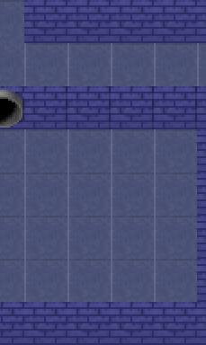
Assigning Responsibility
We have a game board (déjà vu).
Objects are placed on the board.
We will:
  Render the board and the objects.
  Move objects from one position to another.
  Determine which object was clicked on at a given tile.

Slide 14
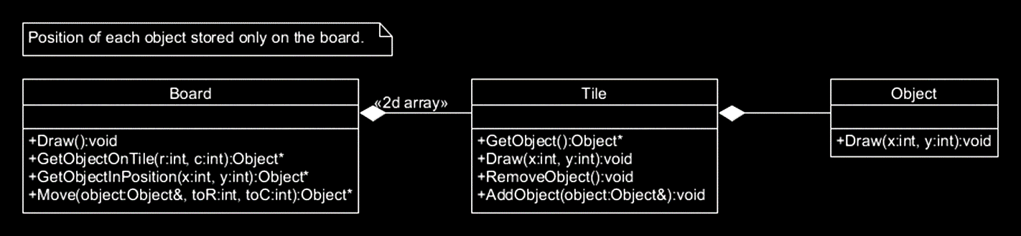
Option A - Classes

Slide 15
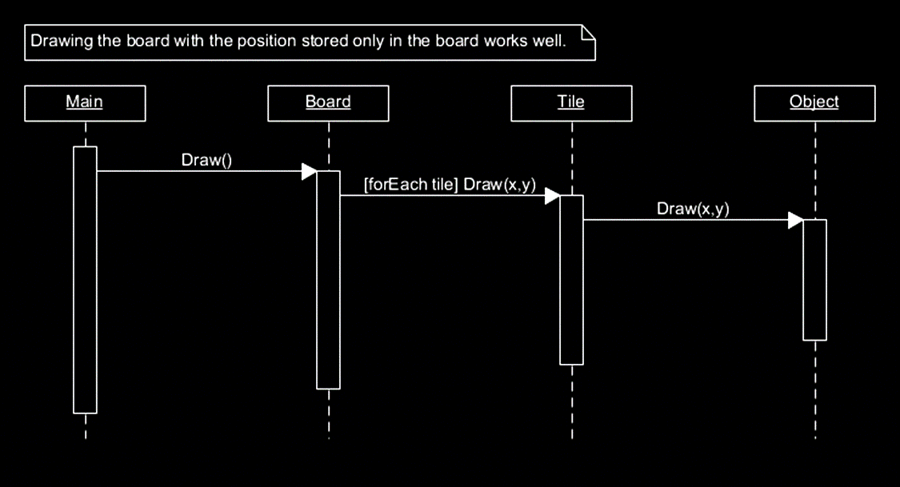
Option A - Drawing

Slide 16

PAUSE
THAT’S A NEW DIAGRAM.

Slide 17
Sequence Diagrams
Represent the process of object interactions.

Slide 18
Sequence Diagrams
Document the order of execution of object interactions.
Reveal logical errors in design.

Slide 19
Symbols
Lets get introduced to all the symbols in a Sequence Diagram.

Slide 20
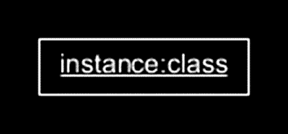
Object
Represents an object in execution.
Looks like a rectangle.
Usually placed at the top.
Is the starting point for a lifeline.

Slide 21
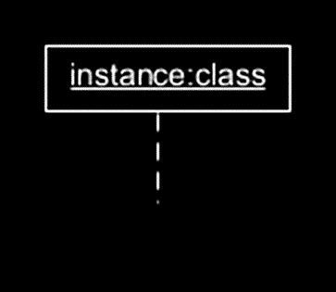
Lifeline
Represent an object over time.
Looks like a dashed line.
Starts with an Object, runs to the end of execution.

Slide 22

Activation Box
Represents the amount of time a process is taking.
Looks like a rectangle running down a lifeline.

Slide 23
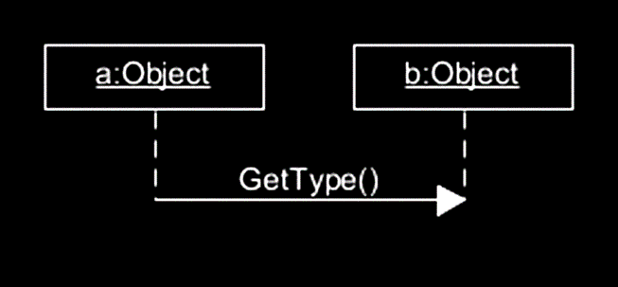
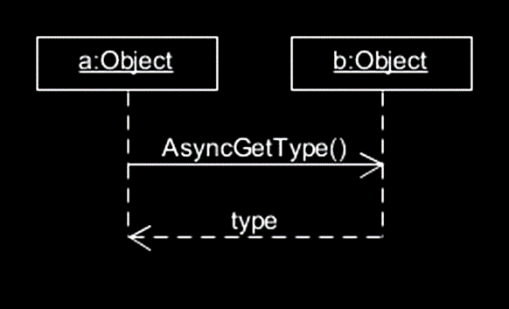
Messages
Synchronous Message
Represents method calls between objects.
Looks like one of several kinds of arrows going from Activation Box to Activation Box.
Asynchronous Message

Slide 24
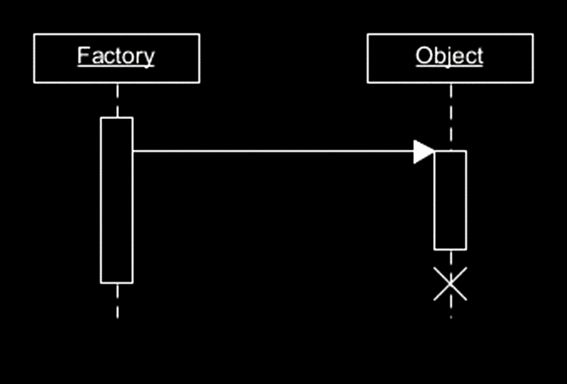
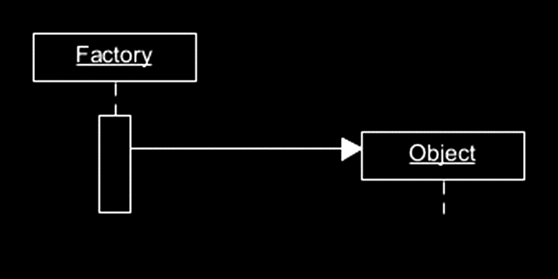
Creating & Deleting Objects
Create
Delete

Slide 25
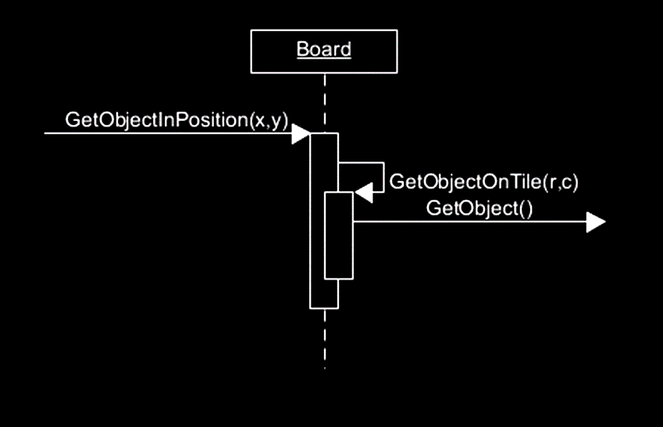
Sub-Process
Represents a process run on top of the existing process.
A method call inside a method call.

Slide 26
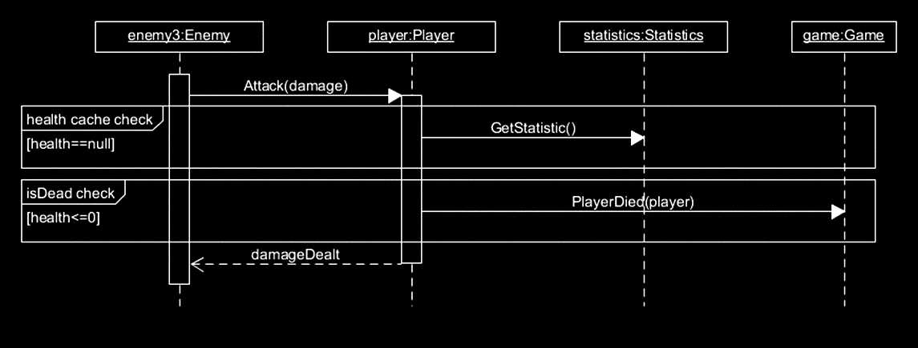
Optional
Describes branches in flow.
Captures if statements.

Slide 27
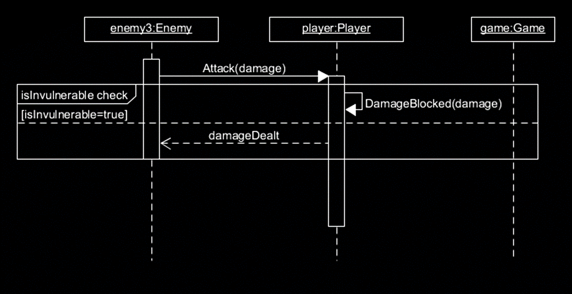
Alternatives
Describes branches in flow.
Captures if else statements.

Slide 28
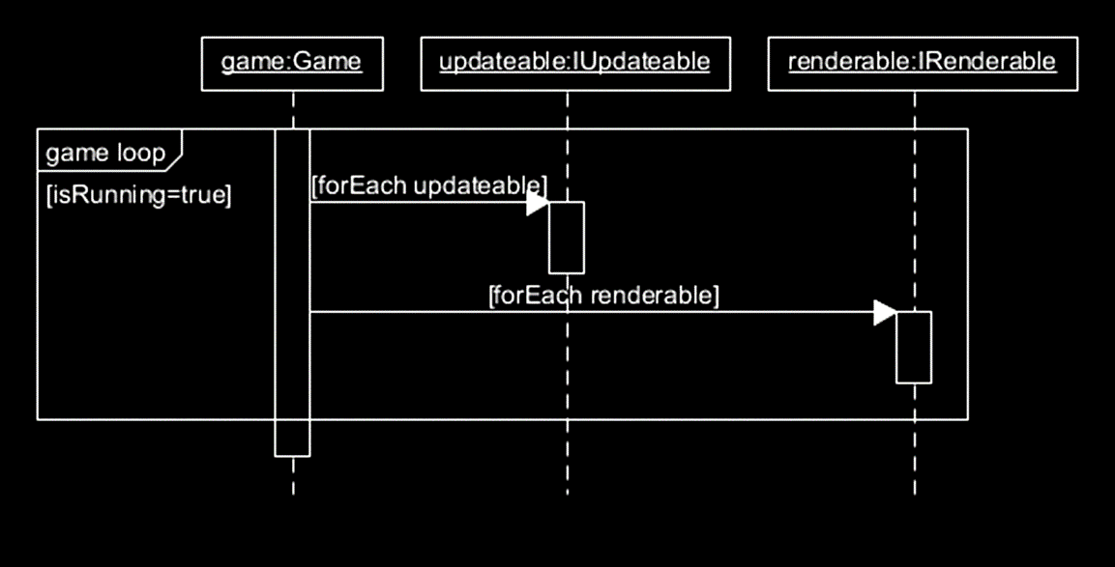
Loop
Describes branches in flow.
Captures a repeating section of flow.

Slide 29
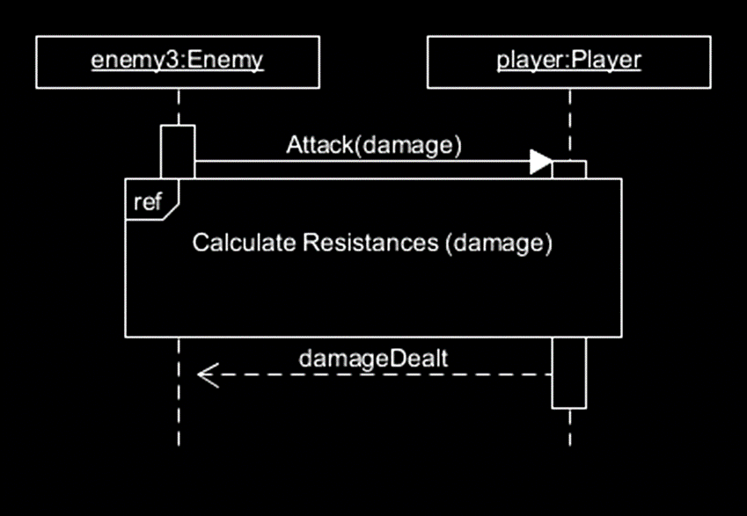
Reference
When one sequence diagram makes use of another.

Slide 30

CONTINUING
WITH THAT OUT OF THE WAY

Slide 31
Assigning Responsibility
We have a game board (déjà vu).
Objects are placed on the board.
We will:
  Render the board and the objects.
  Move objects from one position to another.
  Determine which object was clicked on at a given tile.

Slide 32
Option A - Classes

Slide 33
Option A - Drawing

Slide 34
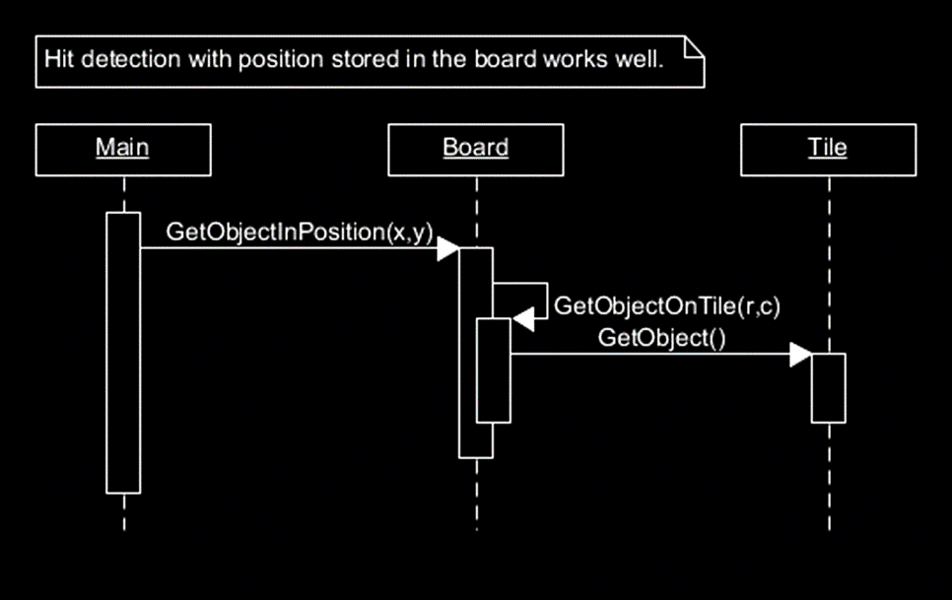
Option A – Hit Detection

Slide 35
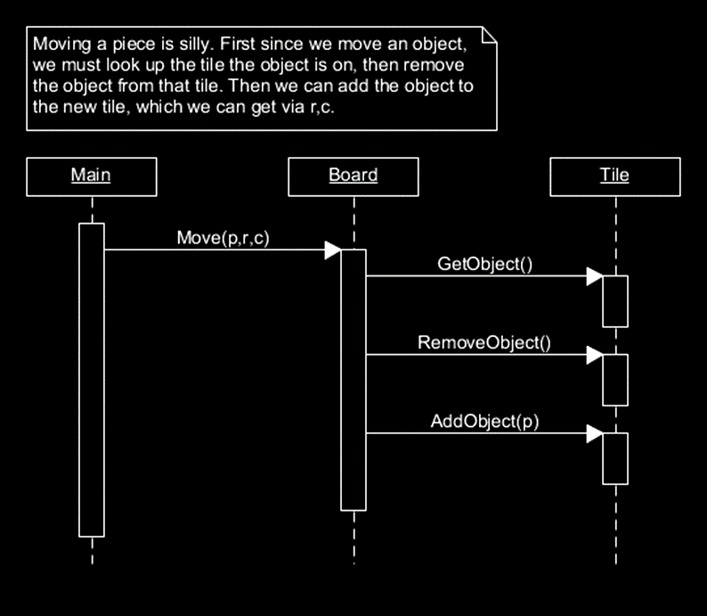
Option A - Moving

Slide 36
Option A
The Bad Option
You ask the board to move the objects.
Moving objects requires first looking them up to remove them from their current tile.

Slide 37
The Better Way!

Slide 38
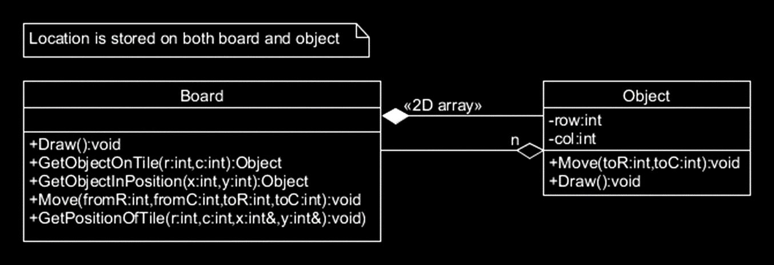
Option B - Classes

Slide 39
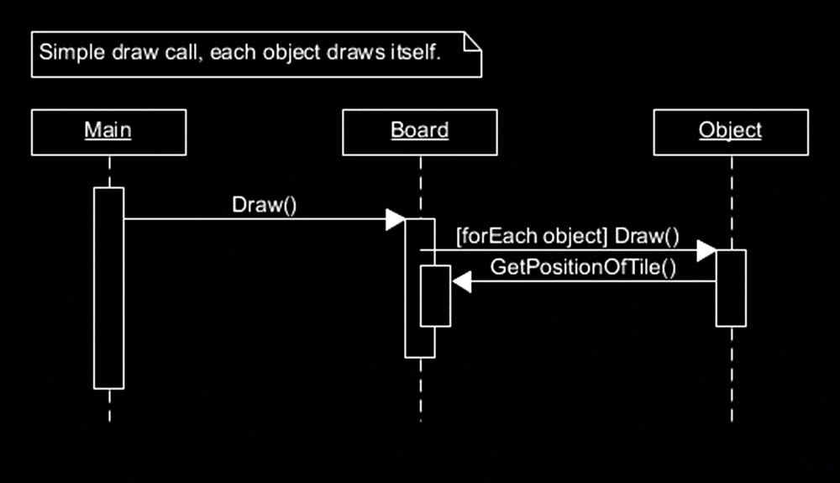
Option B - Drawing

Slide 40
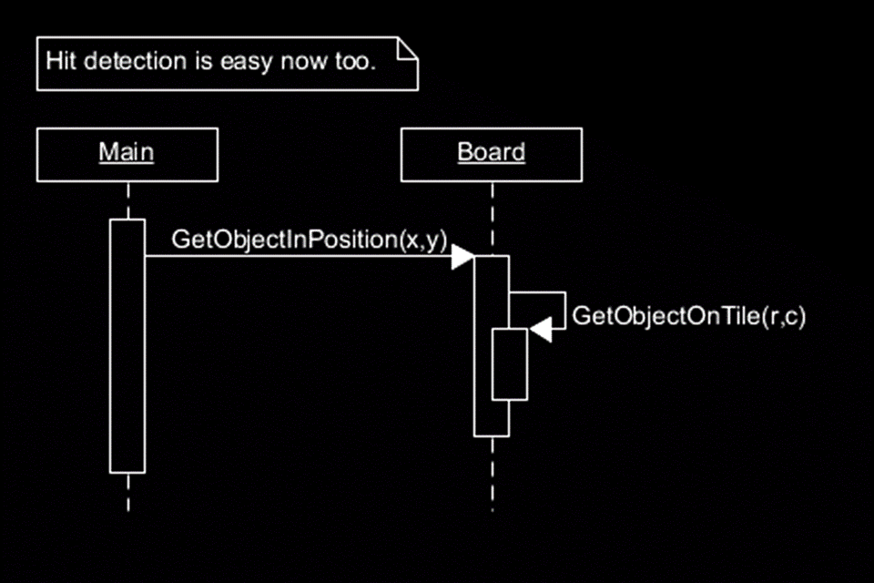
Option C – Hit Detection

Slide 41
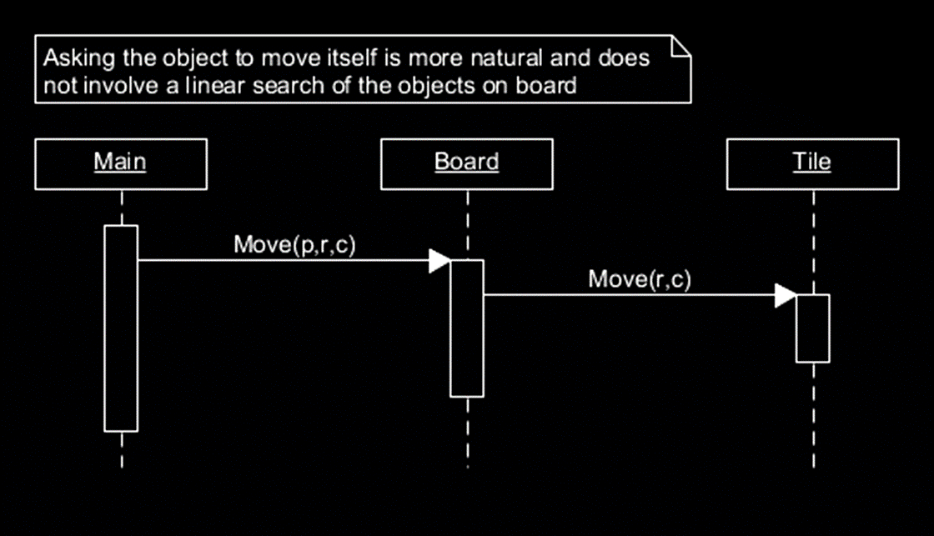
Option B - Moving

Slide 42
Option B
The Good Option
Objects move themselves.
Everything is easier.

Slide 43
Y B & !A ?
Why use Option B and not Option A?

Slide 44
Y B & !A?
The Position of an object is a property of the object, not of the board.
The board should only hold a collection of objects.
In this case the board uses a 2D array for quick indexing (in a primitive sort of way.)

Slide 45
Virtual Destructor
When a child class needs to add extra cleanup functionality.

Slide 46
Consider

Slide 47
Problem!
If we delete the child, the parent destructor is not called.

Slide 48
Solution

Slide 49
Solution
By making the parent destructor virtual when a child destructor is called, the base destructor can still be called.

Slide 50
We are done!
Have a marvelous reading week.

